Slide 1
Automated extraction of optimal visual prompts for foundational models in medical image segmentation
Presented by
1. Dhamale Vivek Shrikrishna (23-1-22864)
2. Pawar Rushikesh Gajanansa (23-1-22581)

Slide 2
Introduction
Challenges in training large-scale deep learning models for medical image segmentation
lack of publicly available data, because of privacy reasons.
lack of quality annotations, because of time consuming nature of task.
One solution could be
Vision foundation models
Recent ongoing approach is to employ promptable foundation models pretrained from natural images and adopt them for medical image segmentation

Slide 3
Introduction
SAM (Segment Anything Model, developed by Meta) (April 2023) [1]
pretrained on natural images to return valid segmentation mask for a relevant prompt
Visual prompts: foreground/background points, a rough box or mask
However, SAMs typically involve providing manual prompts.
Scope of Improvement:
Automating the prompt generation

Slide 4
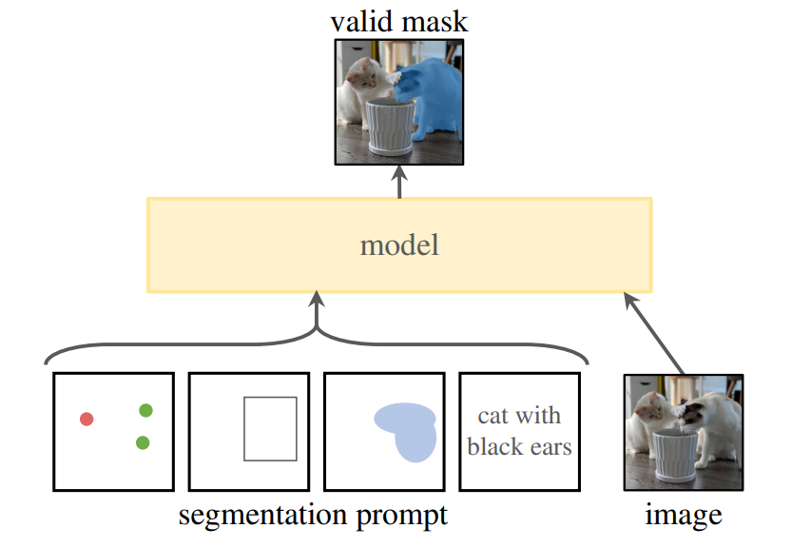
SAM: Promptable segmentation
Image taken from original paper [1]

Slide 5
Literature works
BreastSAM: A Study of Segment Anything Model for Breast Tumor Detection in Ultrasound Images (May 2023)[2]
This study shows that, SAM can be used for segmentation of medical images.
Also compares the performance of SAM with and without prompts and there is a significant increase in performance when prompts are given.
Uses Manual Prompts !!!
MedSAM: Segment anything in medical images (July 2023)[3]
Fine tuned SAM on a large-scale medical image dataset with 1,570,263 image-mask pairs.
It also requires manual Prompts !!!

Slide 6
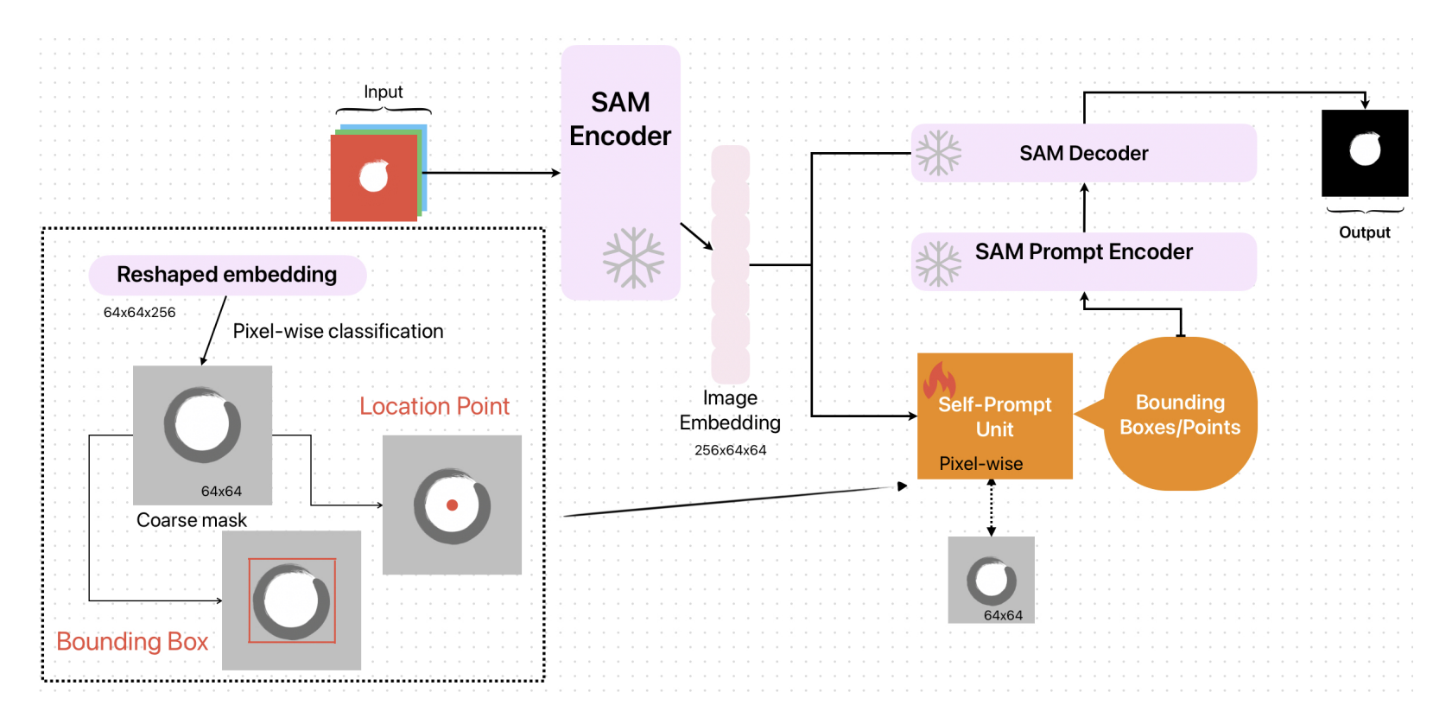
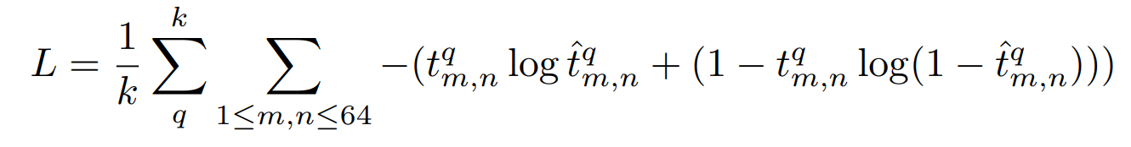
Literature works
Self-Prompting Large Vision Models for Few-Shot Medical Image Segmentation (Aug 2023) [4]
logistic regression to classify each pixel as background or mask to get the coarse mask.
Image taken from original paper [4]

Slide 7
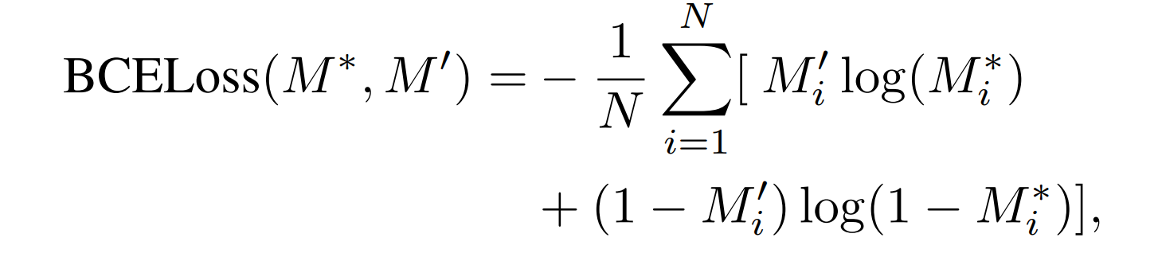
Literature works
Segment Any Cell: A SAM-based Auto-prompting Fine-tuning Framework for Nuclei Segmentation (Jan 2024) [5]
In the segmentation of nuclei, a single image may contain hundreds to thousands of cells, making manual prompting impractical.
Their auto-prompt generator is an auxiliary neural network designed to automate the process of generating prompts.
They used UNet.

Slide 8
Problem Formulation
SAM has shown potential for medical image segmentation, But prompts are required!!
Existing work done in automated prompt generation is limited, and there is still scope of improvement.
In the proposed project, our aim is to investigate different techniques to automatically generate robust visual prompts (e.g., point or bounding box for the area of interest)
that can be later used by SAM for segmentation of anomalies

Slide 9
Proposed Approach
We will explore approaches such class activation maps/feature saliency maps to generate visual prompts for foundation model (SAM).
This work will also involve evaluating accuracy of the downstream segmentation tasks with respect to BreastSAM

Slide 10
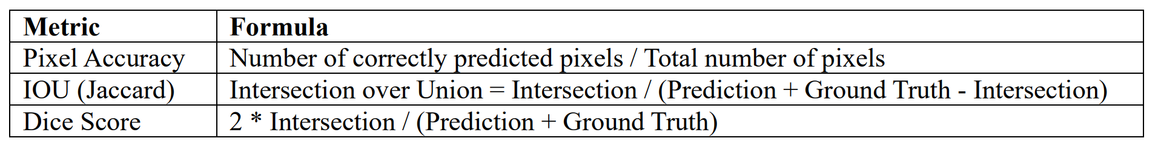
Dataset and Evaluation Criteria
We will use Breast Ultrasound Images from BUSI dataset [6] for initial validation of our method.
Prompts generated should be such that segmentation performance is comparable with results of BreastSAM [2]
Hence, we will use the same metrics of BreastSAM [2]

Slide 11
Future work/Goals
Milestone Presentation (mid March)
Implementation of BreastSAM and getting hands-on experience.
Studying and implementing different CAMs
Final Presentation (May)
Extracting different types of prompts (box, mask, points) from CAMs
Evaluating segmentation performance using our autogenerated prompts against BreastSAM’s performance
Evaluating performance of different types of prompts.

Slide 12
References
[1] | A. Kirillov et al., ‘Segment Anything’, arXiv [cs.CV]. 2023.
[2] | M. Hu, Y. Li, and X. Yang, ‘BreastSAM: A Study of Segment Anything Model for Breast Tumor Detection in Ultrasound Images’, arXiv [eess.IV]. 2023.
[3] | J. Ma, Y. He, F. Li, L. Han, C. You, and B. Wang, ‘Segment Anything in Medical Images’, arXiv [eess.IV]. 2023.
[4] | Q. Wu, Y. Zhang, and M. Elbatel, ‘Self-Prompting Large Vision Models for Few-Shot Medical Image Segmentation’, arXiv [cs.CV]. 2023.
[5] | S. Na, Y. Guo, F. Jiang, H. Ma, and J. Huang, ‘Segment Any Cell: A SAM-based Auto-prompting Fine-tuning Framework for Nuclei Segmentation’, arXiv [eess.IV]. 2024.
[6] | W. Al-Dhabyani, M. Gomaa, H. Khaled, and A. Fahmy, ‘Dataset of breast ultrasound images’, Data in Brief, vol. 28, p. 104863, 2020.

Slide 13
Thank You! Any Questions ???

